Slide 1

Liability and Risk Reduction
A Guide for Estheticians
Associated Skin Care Professionals
800-789-0411
www.ascpskincare.com
getconnected@ascpskincare.com
©2008. All rights reserved.
Notes:
1

Slide 2
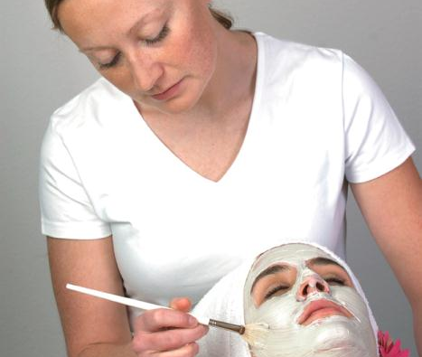
Module 1
Liability
Notes:
These course modules were developed and sponsored by Associated Skin Care Professionals
2

Slide 3
Session Objectives
Appreciate the need to protect yourself by obtaining liability insurance.
Contrast 4 different types of liability insurance.
Summarize why practitioners need liability insurance.
Describe the types of claims typically made against estheticians.
Notes:
3

Slide 4
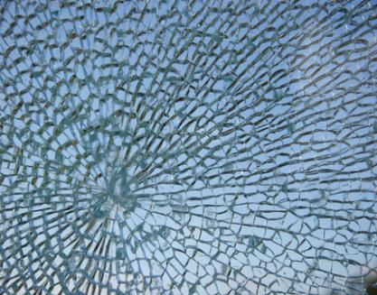
Case Studies
Instrument dropped on a client
Disfigurement
Equipment collapse
Notes:
Provide students with the pre-session case study handouts.
Choose three students to read aloud the pre-session case studies to the class:
Instrument dropped on client
Disfigurement
Slip/Fall
4

Slide 5
Types of Liability Insurance
General
Professional
Product
Claims Made vs. Occurrence Form
Notes:
Let’s review some of the major types of liability insurance:
General
General liability protects you when a client has an accident on your business premises, whether you own it or not. You may be found liable if you are legally responsible for maintaining the area’s safety or were negligent in some way. For example: If your client were to slip and fall, trip over a step and hit their head, even though this kind of injury is not related to the treatment you provided, it may be covered under general liability—if you were found negligent. If your table collapsed, causing injury to your client, damages may be covered under your general liability. If you were to accidentally damage your client’s property, damages may be covered under your general liability. If someone were to damage your property, it would NOT be covered under general liability.
Professional
Professional liability would cover you if you injure a client as the result of providing standard treatment procedures. Let’s say you burn someone, peel their skin off, or cause any other related injury, professional liability insurance would cover you. No matter how careful you are, these types of incidents CAN happen.
Product
Product liability covers you in case of injury caused by the product or if the product produces an adverse reaction, such as a chemical burn or an allergic rash.
Claims-Made vs. Occurrence Form Liability Insurance
Claims-made policies are typically less expensive because they provide less extensive coverage. Claims-made coverage requires claims be made while your policy is in effect. If your policy has expired and someone makes a claim against you (even though you had insurance at the time that client received your services) you will have no insurance coverage because your policy has lapsed. The insurance company has the right, too, to refuse to renew your policy. This could make it difficult to protect yourself.
Occurrence form means coverage continues even if a claim is filed at a later date for an incident that occurred while you were still insured. Many claims aren't filed until the statute of limitations has nearly run out (two years after the incident, in most states). Occurrence form coverage provides protection for these types of claims. Claims-made does not.
5

Slide 6
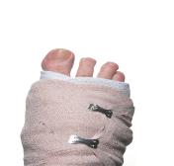
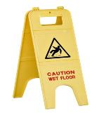
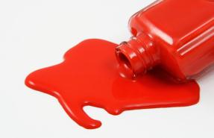
Additional Concerns
Additional Insured Endorsement (AIE)
Requiring insurance of others
Where to obtain liability insurance
Notes:
Additional Insured Endorsement (AIE)
If you are an independent contractor or sub-lessee (booth renter), often a salon or rented space owner will require that their name be listed as an additional insured endorsement (AIE) to also cover them from any liability claims filed by one of your clients. This is because they may also be liable if an incident occurs on their property, even if they were not at fault or the one that provided treatment to the client. This depends on what is required in your lease agreement or contract. You always need to read any contract carefully, if an AIE is not REQUIRED (not a condition of your employment contract/lease), do not request to add them to your policy. Most individual liability policies provide protection for the named individual’s professional liability only and are not intended to provide coverage for business, corporate or employers' general liability exposures.
If you organize your own business as a separate entity, such as a corporation, you may wish to name your corporation as an AIE on your individual liability insurance policy, to protect your business.
Requiring insurance of others
If you are an owner, you should require all contractors to carry insurance. If they are not covered, YOU can be liable and people who have been injured can go after both your personal and professional assets, including property and savings. You should also require your contractors to name your business as an Additional Insured Endorsement (AIE) for further protection.
Where to obtain liability insurance
Do some cost comparisons. You may find that affordable liability insurance is offered through your professional association at no additional cost. You may want to ask your local insurance agent to provide you with a quote or a referral. You can also seek insurance through malpractice companies, though this option may require your paying a higher premium. Your homeowners insurance may require that you purchase a commercial rider (which can be rather expensive) if they discover you are operating a business from your home. The reason for this is simple: the insurance company assumes your risk increases substantially with the increased traffic caused by conducting a business in your home. Choose insurance that will cover you for all forms of liability and a policy that will cover you no matter where or how many settings you provide skin care services.
6

Slide 7


Discussion
How much coverage should a practitioner have?
Why so much?
What if you are a homeowner, property owner, or are perceived as having deep pockets?
Notes:
How much coverage should one have?
Amounts will vary anywhere from $100,000 to $1 million of coverage per category of liability. Large groups or associations may have coverage up to $3 million each in general, product and professional liability.
Why so much?
You may have multiple lawsuits in any given period and these can add up. You also want to make sure you have enough protection for any type of claim, and enough to protect all your personal and business assets. If you don’t have enough insurance, you may have to pay the difference out of your pocket.
What if you are a homeowner, property owner or have deep pockets?
You are at greater risk for losing your assets. Even if you don’t have deep pockets…can you afford a $25,000 legal bill and/or the loss of future earning potential?
7

Slide 8
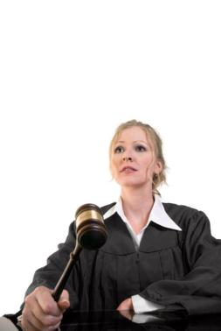
Negligence
Define liability risk exposure or occurrence.
Who can get sued?
Do not make false assumptions.
Notes:
Introduction Question: Let’s turn the tables. What would you do if you were a professional who met with clients all day, and your practitioner burned your face?
Define Liability Risk Exposure or Occurrence
A liability risk exposure or occurrence is any event that could result in a claim or lawsuit alleging your negligence. This can be because the client slips and falls or caused by a treatment performed by the esthetician.
Who Can Get Sued?
Everyone involved can get named in the lawsuit. The owner, manager AND YOU, can all be named in the suit.
This is one of the most important points to be made in this session. Do not make false assumptions about whether you are covered by your employer. Employers or owners may not automatically cover you. You need to ask! Remember, an employer’s policy will typically only provide coverage for services you perform at their facility and nowhere else.
8

Slide 9
Questions to Ask Employers
Will your employer provide you with a copy of the policy for you to review?
Does their policy cover you for all services you are performing?
When does the policy come up for renewal?
In the event of a claim, will it cover your legal defense?
Notes:
If your employer provides your professional liability insurance, there are several important questions to ask.
Will your employer provide you with a copy of the policy for you to review?
Does their policy cover you for all services you are performing?
When does the policy come up for renewal?
In the event of a claim, will it cover your legal defense?
9

Slide 10
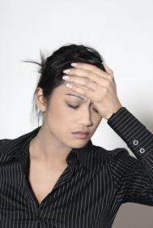

Discussion
Court TV
Were claims always valid?
How did the cases turn out?
Notes:
Discussion
Ask students about other lawsuits they’ve seen on TV or through friends.
Were the claims always valid?
How did some of these cases turn out?
10

Slide 11
Example of Claims Made
Against Estheticians
Product/equipment problems
Injury caused by esthetician during the treatment
Client suffers injury due to accident (not caused by treatment)
Alleged problems with no real incident
Notes:
Describe some examples of the types of claims typically made against estheticians:
Product problems
Do not always assume that these have been previously reported to the manufacturer. Products can cause even minimal side effects, which can lead to complaints. Pay attention and beware when using a product with which you have little experience.
Accidents caused by the esthetician
Leaving a product on too long, burning a client with tools that are too hot are common incidents. Even experienced practitioners can make mistakes. These are often caused by interruptions or lack of focus. Minimize anything that may cause a distraction during treatment.
Client suffers an injury due to an accident (not caused by treatment)
This can occur because the client left the medical history blank on their intake form, but they were using Acutane. Their skin peeled off when a chemical exfoliation agent was removed. Even though the client failed to disclose the risk, the esthetician remains at risk for a claim.
Alleged problems with no real incident
There are times when someone claims a problem that didn’t really occur. But it’s your word against their word. Documentation is essential in this and all cases.
Ask for examples from the group.
Discussion
How do you distinguish what’s honest and what could be fabricated by the client? Does that make a difference? You can only document the facts.
11

Slide 12
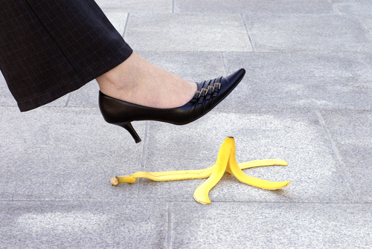
Module 2
Risk Reduction
Notes:
Optional module if students have not had risk reduction in their curriculum.
12

Slide 13
Session Objectives
Identify key risk reduction strategies.
Recognize what to do if an incident occurs.
Understand the reasons to obtain liability insurance.
Notes:
13

Slide 14

Keep Accurate Records
Always keep notes on every client visit.
Document what treatment was done and which products were used.
Notes:
14

Slide 15
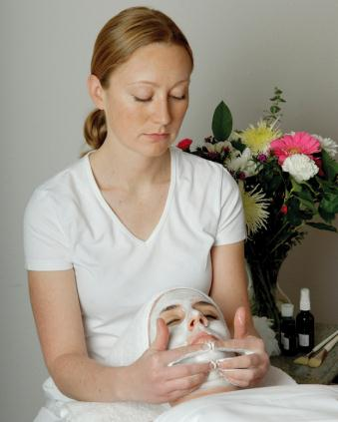
Health History and Waiver
Always have clients complete a health history, even if they are friends.
Use waiver forms.
Update forms regularly.
Verbally review forms with client.
Notes:
15

Slide 16
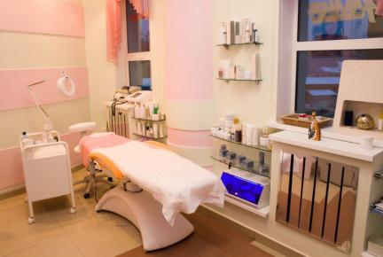
Maintain a Safe Work Environment
Safety checks should be done (and documented) routinely.
Clear distractions.
Check tables or anything that supports the client.
Beware of slippery surfaces (i.e., ice in winter).
Clean spills immediately.
Notes:
Additional Comment: Distractions are not only a threat to your client’s safety, but also to your own safety. Do maintain a focus on your work.
16

Slide 17

Relationships
A strong relationship may prevent a client from suing.
Use open communication.
Notes:
17

Slide 18

After Treatment Precautions
Instruct your clients carefully.
  What they should expect.
  What they should do when they get home.
Provide both written and verbal instructions.
Document your instructions.

Slide 19
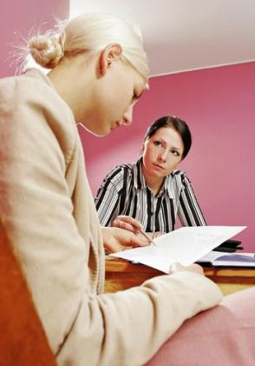
Ensure Privacy
Provide a private space to review health history or discuss issues.
Never discuss a client case in front of another client or with a friend.
Don’t be overheard.
Do not gossip.

Slide 20
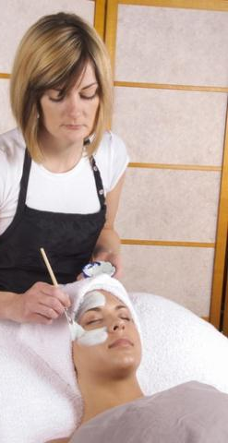
Discuss Potential Risks
Always counsel clients about risks with a product or procedure.
Remind them of risks each time you see them.
Document what you’ve discussed.
Perform a patch test before treatment.
Notes:
20

Slide 21
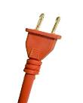

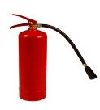
Check Heat Sources
Unplug heat sources and small appliances.
Limit the use of candles and always use candle holders.
Remember that heat causes risk to both clients and property.
Locate the nearest fire extinguisher.
Notes:
21

Slide 22
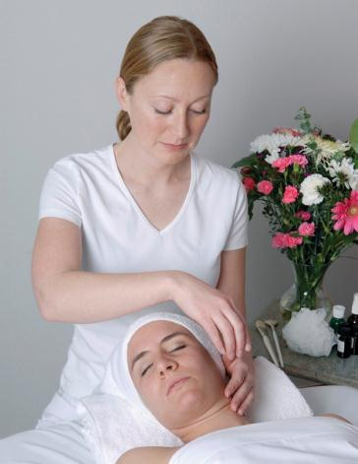
Drape Clients
Avoid harming your client.
Preserve your clothes.
Protect your credibility.
Always drape the client.

Slide 23

Unsafe Procedures
Do not practice outside of your scope.
Do not use products unless you have received sufficient, formal training.
Don’t perform unproven or unorthodox treatments.
Never put the client at risk with an unsafe procedure.
Notes:
(The photo is an ear candle being extinguished in water).
23

Slide 24
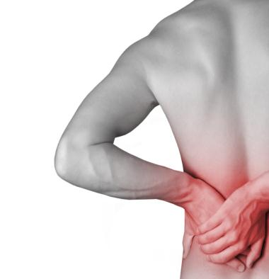
Use Caution When Applying Heat
Heat is the greatest source of risk.
Burns are very costly to treat.
Loss and injury lead to significant lawsuits.
Notes:
24

Slide 25

Check Equipment Daily
Have a daily checklist to check all equipment.
Place your checklist in a folder.
Maintain for at least one year.
Documentation can help your defense if you have a claim from equipment failure.

Slide 26
When in doubt…
Refer Out !
Notes:
If a client appears to have a condition that warrants treatment beyond your scope of practice as an esthetician, refer your client to seek medical attention.
26

Slide 27
Discussion
Why are problems not felt immediately?
Why is developing a relationship with clients so important?
Notes:
Just because a client reports that they feel OK at the moment, does not mean that they will not feel pain at a later time. Anticipate the worst case scenario by keeping the best documentation you can, and assisting the client to seek medical help if warranted. Discuss why pain and injury sometimes appear later.
Why is developing a good relationship so important, if an incident occurs? Does it make up for problems with your product or your own practices?
It might! Studies have shown that your risk of lawsuit is reduced when the client has a closer relationship with you than when you don’t; however there is NEVER a guarantee.
27

Slide 28
If an incident occurs:
Assess injuries. Obtain medical help; seek treatment immediately.
Don’t get defensive or hostile; don’t admit fault.
Take photos, if possible. Write a detailed account of actions and conversations.
Contact your insurance carrier immediately.
Know what your carrier suggests before an incident happens.
Notes:
The following should be done immediately if an incident occurs where someone is injured.
Assess injuries.
Ask the client to describe how they are feeling and describe any discomfort.
Do not be overly defensive or hostile to client.
Do what you can to soothe the situation. Many times, minor claims are dropped once the client’s initial emotional anger diminishes.
Take photos/write detailed account of actions and conversations.
Whether you use a cell phone or any camera, document the problem. Tell the client that you want to document the extent of the case. Write down every detail you can remember during or immediately after your conversation and intervention with the client. Everything you officially document can be discovered in court, so document ONLY the facts. Do not write impressions or feelings in your documentation. You can write those down in a separate place.
Contact your carrier ASAP and get counseled on further communications with client.
Your liability carrier will counsel you about how to deal with follow-up with the client. Do not delay in calling them. They may suggest that you cut off all communication with the client or they may encourage you to follow up with them. Follow their directions.
Know what your carrier suggests BEFORE an incident happens.
When you take out insurance, call your carrier and ask what resources they have for risk reduction and what procedure they have for reporting a potential claim. Each carrier may ask you to document things a little differently, so it’s a good idea to ask in advance.
Obtain medical help, if warranted, or encourage them to see treatment immediately.
Do not wait to find out about your insurance coverage. Your client’s safety and well-being should always come first.
28

Slide 29
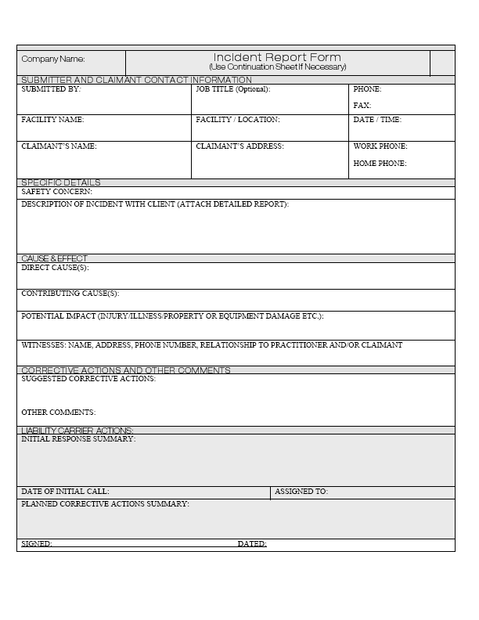
Case Studies
What type of liability is this situation?
How could this situation have been prevented?
What immediate action should the esthetician take?
Complete the sample incident report.
Notes:
29

Slide 30
Liability and Risk Reduction
A Guide For Estheticians
©2008. All rights reserved.
Developed and Sponsored by
Associated Skin Care Professionals
800-789-0411
www.ascpskincare.com
getconnected@ascpskincare.com

